Slide 1
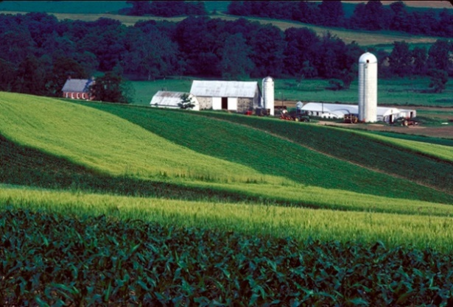
ARS Midwest Area Technology Transfer
Technology Transfer
and the Interfaces with the
Research Unit,
MWA Technology Transfer Office,
and Headquarters Office of Technology Transfer (Patents)

Slide 2
MWA Technology Transfer Office and ARS Office of Technology Transfer
Area Level: Technology Transfer Coordinators
Headquarters:
Patent Advisors Licensing Agents

Slide 3
Technology Transfer: the process by which research results are adopted and put into practice

Slide 4
Examples of ARS Technology Transfer
Licensing and commercialization of federal inventions
Other forms of technology transfer
Scientific journals and presentations
Trade journals and grower/producer publications
Public databases and websites
Demonstrations, field days, grower presentations
Public release of germplasm
Patents
Plant Variety Protection Certificates
Biological Material Inventions

Slide 5
How do we manage and protect inventions and intellectual property rights in ARS?
Use appropriate agreements:
Confidentiality Agreements
Material Transfer Agreements
Cooperative research agreements
Protect inventions (patent, etc.)
if determined to be in agency’s interest and needed to facilitate transfer or adoption of the technology

Slide 6
Confidentiality Agreements and Material Transfer Agreements
Protects ARS’ rights in intellectual property.
Reviewed and approved by MWA Tech Transfer Office.
Standard ARS formats should be used.
Cooperator formats must be approved by MWA TT.
CA’s: provide/receive confidential information to/from another party to discuss inventions or potential collaborations (1 year).
MTA’s: provide/receive materials to/from another party for research ONLY (1-5 years).

Slide 7
Confidentiality Agreements and Material Transfer Agreements
NO collaborative research or obligation of research.
MWA TT enters information into database in ARIS.
Only outgoing fully executed MTA’s appear in tech transfer section of annual reports.
Contact MWA TT if questions about what type of agreement to use.

Slide 8
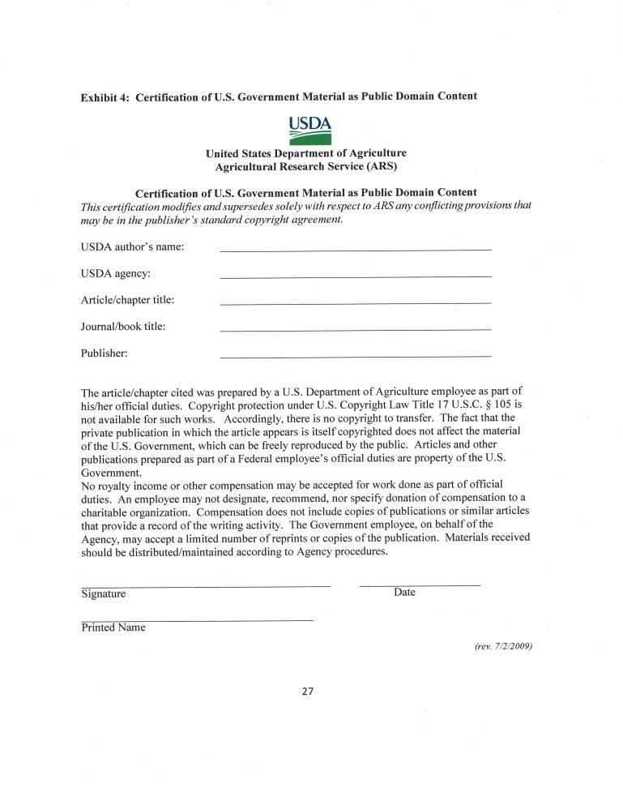
Copyright and Editor Agreements
Copyright Agreements: Send standard ARS form, completed and signed, attached to Publisher agreement (P&P 152.1 ARS)
Contact MW TT if publisher
will not accept ARS form
Book chapters/Editor agreements:
Contact MWA Ethics Advisor FIRST

Slide 9
Partnering to Facilitate Technology Transfer
Enables collaborative evaluation, implementation or development of ARS technologies
Provides access to ARS expertise in research areas of mutual interest
Leverages assets/expertise of both parties
Agreements are used to identify expectations and to manage and protect intellectual property rights of both ARS and partners.

Slide 10
Cooperative research agreements
Defines the scope of work – what and how
Identifies resources to be contributed by each party
Identifies expectations, responsibilities and obligations of all parties
Identifies how new intellectual property and publications/public disclosures of the results will be managed

Slide 11
ARS Cooperative Research Agreements
Technology Transfer (MWA)
Extramural Agreements
Division (BSC)
Cooperative Research and
Development Agreements
(CRADA)
Material Transfer Research Agreements (MTRA)
Trust Fund Agreement
Reimbursable Agreement
Specific Cooperative Agreement
Assistance-type Cooperative Agreement
Non-funded Cooperative Agreement
Office of International Research Programs
Assists in development of cooperative research projects with international research community

Slide 12
Material Transfer
Research Agreements
Transfer of materials AND collaborative research.
May receive, provide or exchange materials
Currently may be used in conjunction with Non-Funded, Trust or Reimbursable Agreements
Currently not used with outgoing funding agreements (can use separate MTA).

Slide 13
Cooperative Research and Development Agreements (CRADA’s)
Allows businesses and federal laboratories to form partnerships that help move new technologies into the commercial marketplace.
Special type of Trust Agreement:
licensing of intellectual property
*confidentiality and FOIA
SOW cannot overlap with other cooperative agreements

Slide 14
MTRA’s and CRADA’s (Initiated and routed through MWA TT to Headquarters OTT)
Scientist/RL contacts MWA TT to discuss and develop proposed SOW.
For CRADA, MWA TT submits preliminary SOW for approval by line and program management before proceeding to develop final agreement with cooperator.
Details finalized and MWA TT requests ARIS entry by Unit (MWA TT provides information to Unit for ARIS and AIMS; AIMS can be added when ARIS approved).
ALL MTRA’s and CRADA’s must be approved by ONP, regardless of the level of funding

Slide 15
Cooperative agreements involving Bioenergy Research Center funding
Project in which collaborating institution is funded by a DOE Bioenergy Research Center:
Falls under terms of MOU between USDA and DOE (specialized intellectual property requirements)
Collaboration requires executed agreement with ARS (no funds to ARS and a specialized NFCA is used)
Scientist should contact MWA TT to discuss and develop SOW
SOW cannot overlap with other cooperative agreements

Slide 16
CRADA’s and Outgoing Funds
Outgoing from CRADA funds the exception and limited use
All parties with research responsibilities that may contribute to CRADA inventions should be CRADA partners
Outgoing funds must be identified in the CRADA and SOW approved in advance by MWA TT (used for expertise not available from CRADA partners, but which will not contribute to potential CRADA inventions)
Issues of CRADA confidentiality must be addressed

Slide 17
ARIS actions and issues of confidentiality
Publications: ARS-115 for approval. If potential for IP, mark appropriate box and discuss with Patent Advisor prior to submission to journal (interpretive summary and technical abstract on TEKTRAN)
Annual Report: AD-421 eventually becomes public information on ARS website and may be used in reports to Congress and other organizations (if potential IP, discuss with Patent Advisor prior to submission for suggested revisions) (CRADA information is confidential!)
Cooperative Agreements: Title, Objectives and Approaches for executed agreements posted on the ARS website (except CRADA’s). MWA TT will refer any concerns to Patent Advisor when ARIS action received at Area level.

Slide 19
Headquarters OTT (patents)
ARS inventions
Disclosure issues (including review of publications, posters, abstracts, annual reports…)
Co-owned inventions when Cooperator is filing patent application
Invention disclosure process
Assignment of rights for inventions
Related processes

Slide 20
MWA Technology Transfer Office
Material Transfer Agreements
Confidentiality Agreements
CRADA’s
Material Transfer Research Agreements
Copyright and other IP agreements
What kind of agreement to use?

Slide 21
MWA Technology Transfer Office
Public germplasm releases (review release notice)
Plant Variety Protection Certificates (committee)
Biological material inventions (disclosures)
Potential licensees for ARS inventions
CRADA publications/release of CRADA information
Review ARS press releases and articles (IP, CRADA)
Tech transfer/IP management plans in grant proposals
Confidentiality issues/potential IP in annual reports, ARIS actions, etc...
Contributions to ARS annual tech transfer report
(non–IP tech transfer, such as field days, etc.)
Reviews and submits FLC tech transfer nominations

Slide 22
Contacts for Midwest Area
Midwest Area (Peoria, IL)
Technology Transfer
Renée Wagner (Technology Transfer Coordinator)
Babette Davis (Technology Transfer Assistant)
Headquarters OTT (Peoria, IL)
Patents
Albert Tsui (Patent Advisor)
Sheri Whitehurst (Sr. Legal Administrative Specialist)

